Slide 1


JMS + Spring Integration
2
Brasov, Martie 2010

Slide 2
JMS – few words
Sender
Receiver
JMS Broker
Sender
Receiver
Sender
Receiver
Publisher
Topic
Subscriber
Subscriber
Subscriber
Producer
Queue
Consumer

Slide 3
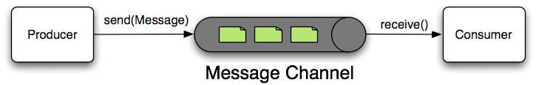
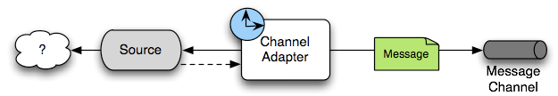
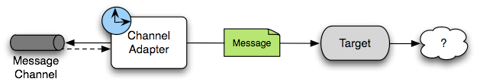
Spring Integration – few words

